Slide 1
Domain Name Server (DNS) Filtering Service using Threat Intelligence feeds and AI/ML Techniques
CSE7101- Capstone Project
Review-1
Batch Number: CSE 75
Under the Supervision of,
Dr. Ayesha Taranum
Professor
School of Computer Science and Engineering
Presidency University
Roll Number 20221CSE0309 20221CSE0346 20221CSE0367 | Student Name Saish Savadatti Suhas C Lingana Gouda
Name of the Program: B.Tech
Name of the HoD: Dr Asif Mohamed H B
Name of the Program Project Coordinator: Dr.Jayavadivel Ravi
Name of the School Project Coordinators: Dr. Sampath A K , Dr. Geetha A

Slide 2
Content
Problem Statement
Objectives
Background and Related work for title Selection
Analysis of Problem Statement
Innovation or Novel Contributions
Git-hub Link
Timeline of the Project
References

Slide 3
Problem Statement Number: PSCS_180
Organization: Indian Space Research Organisation (ISRO)
Category (Hardware / Software / Both) : Software
Problem Description:
Malicious domains and phishing attacks threaten network security by enabling malware communication
with command-and-control servers. Existing DNS systems lack efficient mechanisms to block such domains
and detect complex threats like DNS tunneling and botnet-generated domains. A secure, intelligent DNS
filtering solution is needed to proactively prevent security breaches while ensuring seamless resolution of
legitimate domains.

Slide 4
Analysis of Problem Statement
Objectives :
Develop a secure DNS resolver that blocks resolution of malicious domains.
Utilize threat intelligence feeds supporting STIX/TAXII protocols for up-to-date threat data.
Implement AI/ML techniques to identify malicious domains generated by domain generation algorithms (DGA) and other botnet methods.
Detect DNS tunneling attempts used by malware for covert communications.
Support DNS over UDP, DNS over DTLS, and DNS over HTTPS protocols.
Ensure scalability to handle high volume DNS queries with average lookup time under 100 milliseconds.
Offer a web interface to monitor malicious domains and source IP statistics.

Slide 5
Analysis of Problem Statement (contd...)
Key Challenges:
Rapidly evolving malicious domain generation techniques.
Need for low-latency DNS resolution to maintain user experience.
Integration of multiple security data sources and dynamic threat intelligence.
Effective detection of sophisticated DNS tunneling behavior.
Scalability for large-scale DNS query loads typical in space or government networks.
Proposed Solution :
AI/ML powered DNS filtering system integrated with threat intelligence feeds, scalable architecture supporting multiple DNS protocols and real-time active/passive analysis.

Slide 6
Analysis of Problem Statement (contd...)
Technology Stack Components :
DNS Server: Bind9 or custom resolver implementation.
AI/ML Framework: Python (scikit-learn, TensorFlow, PyTorch) for domain classification and anomaly detection.
Threat Intelligence Integration: STIX/TAXII clients for feed ingestion.
Network Analysis: Passive capture analysis using Zeek and PCAP parsing tools.
Protocols Supported: DNS over UDP, DNS over DTLS, DNS over HTTPS.
Web Interface: React.js / Angular for frontend; Flask / Django for backend API.
Database: PostgreSQL / NoSQL for domain data, logs, and analytics.
Security: SSL/TLS for encrypted DNS protocols.

Slide 7
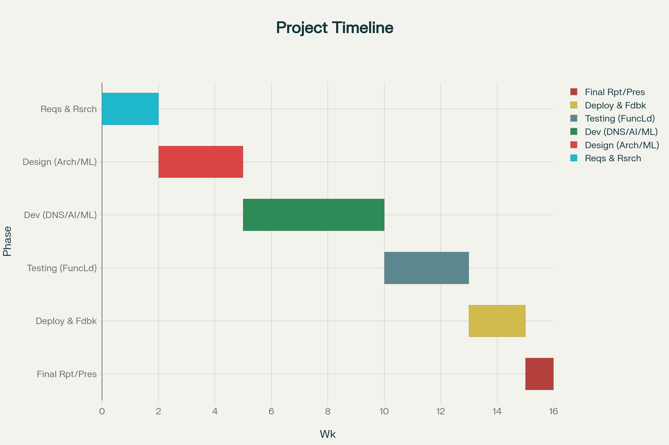
Timeline of the Project (Gantt Chart)

Slide 8
Github Link
Github Link :
https://github.com/FlameHyde/DNS--Threat-Intelligence

Slide 9
References (IEEE Paper format)
Cyber Threat Intelligence Using STIX and TAXII, MITRE Corporation, 2023.
R. Villamarín-Salomón, et al., “Detection of Domain Generation Algorithms with Machine Learning,” IEEE Access, 2022.
M. Zhang, “DNS Tunneling Detection Based on Statistical Analysis,” Computer Networks, 2021.
Indian Space Research Organisation, Cybersecurity Framework, 2024.

Slide 10


